Slide 1
Fraud Detection and Analysis: Machine Learning Approach
Name - Mamidyala Sarayu

Slide 2
Executive Summary
Problem: Fraudulent transactions cause significant financial losses in payments
Solution: Machine Learning model with real-time fraud detection capability
Key Results:
  Total Transactions Analysed: 11,143
  Fraudulent Transactions Detected: 1,142
  Fraud Rate: 10.38%
  Total Fraud Amount: ₹1,362M
Business Impact: Potential to save significant losses through early fraud detection

Slide 3
Project Overview
Objective: Enhance the accuracy of detecting fraud in mobile financial transactions using ML
Goal: Develop a production-ready model for real-time fraud detection
Business Benefits:
  Improve security & reduce financial losses
  Identify fraud patterns & risk factors
  Enable data-driven decision making
Deliverables:
  Production-ready ML model
  Comprehensive performance analysis
  Power BI analytics dashboard
  Financial impact analysis

Slide 4
Dataset Overview
Dataset Size: 11,054 transactions
Data Source: Existing database
Time Period: 100 hours of transaction data
Key Columns:
  Transaction Amount, Type (TRANSFER, CASH_OUT, CASH_IN, DEBIT, PAYMENT)
  Customer/Merchant Details (nameOrig, nameDest)
  Account Balances (oldBalance, newBalance)
  Target Variable: isFraud (0 = Legitimate, 1 = Fraudulent)
Data Quality:
  No missing values
  No duplicate records
  Class imbalance: 10,381 legitimate vs. 1,142 fraudulent

Slide 5
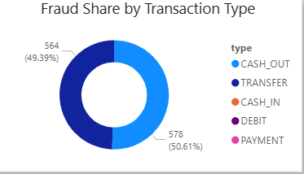
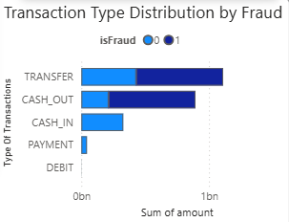
Exploratory Data Analysis (EDA) - Part 1
Transaction Distribution:
  Total Transactions: 11,054 (pie chart showing fraud vs. non-fraud)
  Fraud Rate: 10.38%
Transaction Types:
  TRANSFER: Highest volume
  CASH_OUT: Second highest
  CASH_IN, DEBIT, PAYMENT: Lower volumes
Fraud Distribution by Type: (Bar chart from dashboard)
  CASH_OUT: 46% of frauds
  TRANSFER: 37% of frauds
  CASH_IN: 16% of frauds

Slide 6
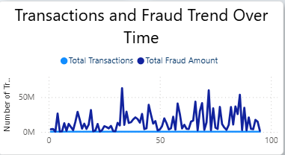
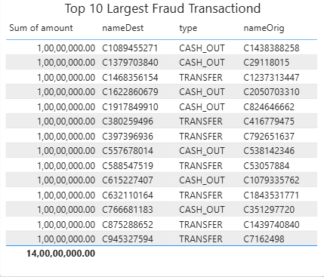
Exploratory Data Analysis (EDA) - Part 2
Temporal Analysis:
    Fraud Trend Over Time (line chart from dashboard)
    Peak fraud hours identified
Transaction Amount Analysis:
    Min: ₹0, Max: ₹92.4M
    Mean: ₹17.5M (fraudulent transactions)
    Outliers present in high-value transactions
Top Fraudulent Transactions Table:
  The "Top 10 Largest Fraud Transactions" table visual highlights high-value frauds, enabling targeted review and potential audit.
  All top frauds are either CASH_OUT or TRANSFER types and involve significant amounts.

Slide 7
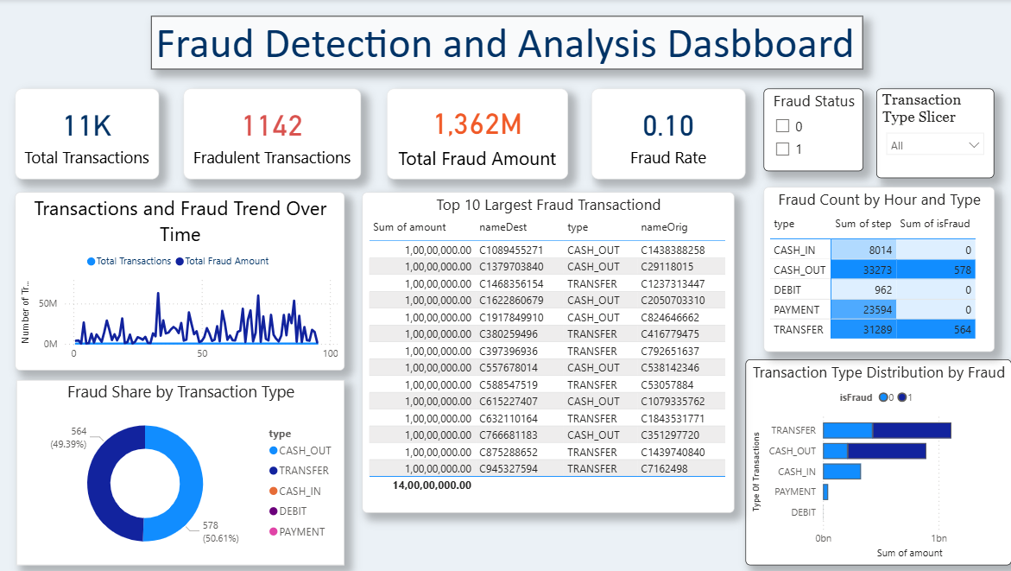

Slide 8
Data Preprocessing & Feature Engineering
Steps Performed:
  Removed irrelevant columns (nameOrig, nameDest)
  Created engineered features:
    orig_bal_diff = oldbalanceOrg - newbalanceOrig
    dest_bal_diff = oldbalanceDest - newbalanceDest
    orig_ratio = amount / (oldbalanceOrg + 1)
    dest_ratio = amount / (oldbalanceDest + 1)
  One-Hot Encoding for type variable (TRANSFER, CASH_OUT, etc.)
  StandardScaler normalization applied to numerical features
Class Imbalance Handling:
  Applied SMOTE (Synthetic Minority Over-sampling Technique)
  Balanced training data: Original (10,381: 1,142) → Resampled (10,381: 10,381)

Slide 9
Machine Learning Models Evaluated
4 Models Trained & Tested:
  Logistic Regression - Baseline model
  Random Forest Classifier - Ensemble with 200 estimators
  Gradient Boosting Classifier - Sequential boosting
  LightGBM Classifier - Optimized gradient boosting
Train-Test Split: 80-20 with stratification
Resampling Method: SMOTE on training data

Slide 10
Model Performance Comparison
Metric | Logistic Regression | Random Forest | Gradient Boosting | LightGBM
Precision | 0.8696 | 1.0000 | 0.9956 | 0.9956
Recall | 0.9649 | 0.9912 | 0.9956 | 0.9956
F1-Score | 0.9148 | 0.9956 | 0.9956 | 0.9956
ROC-AUC | 0.9908 | 1.0000 | 1.0000 | 0.9999
Accuracy | 0.9816 | 0.9991 | 0.9991 | 0.9991

Slide 11
Best Model - Detailed Analysis
Confusion Matrix Visual:
  TP: 227 | TN: 2,000 | FP: 1 | FN: 1
  Fraud Prevented: ₹235,430,525
  Fraud Missed: ₹416,001
  Net Benefit: ₹235,013,774
  Annual: ₹20,570,749,977
Classification Report:
  Class 0 (Legitimate): Precision, Recall, F1
  Class 1 (Fraud): Precision, Recall, F1

Slide 12
Feature Importance Analysis
Interpretation:
  Ratio Features (orig_ratio, dest_ratio): Abnormal transaction patterns relative to account balance
  Balance Changes: Unusual account balance modifications before/after transactions
  Transaction Amount: High-value transactions show higher fraud likelihood
  Transaction Type: TRANSFER & CASH_OUT inherently riskier than other types

Slide 13
Financial Impact Analysis
Calculations Based on Model Performance:
✓ Fraud Prevented | ₹235,430,525
✗ Fraud Missed | ₹416,001
✗ Investigation Cost | ₹750
Net Benefit | ₹235,013,774
Annual Projection: ₹20,570,749,977 (₹20.57 Billion)
Business Value:
This model is projected to prevent approximately ₹20.6 billion in mobile payment fraud annually. With 99.6% recall and only 1 false positive, the model balances fraud detection with minimal customer impact.

Slide 14
Business Recommendations
Operational Insights :
  Focus monitoring on peak fraud hours identified in the dashboard
  Prioritize CASH_OUT and TRANSFER transactions for review
  Flag transactions with extreme orig_ratio & dest_ratio values
Risk Mitigation Strategies:
  Implement the model in real-time transaction screening
  Set alerts for transactions above fraud risk threshold
  Establish investigation workflow for flagged transactions

Slide 15
Model Limitations
Data Limitations:
  Dataset covers 100 hours only (time-bound)
  Historical fraud patterns may evolve
  Geographic/demographic patterns not included
Model Limitations:
  No new fraud types not seen in training data
  Class imbalance addressed, but may still impact recall
  Model drift is possible over time
Operational Constraints:
  Real-time predictions require API integration
  Computational resources for production deployment

Slide 16
Future Work & Scalability
Model Enhancements:
  Incorporate customer behaviour history
  Add network analysis (detecting fraud rings)
  Ensemble stacking of multiple models
  Hyperparameter tuning for better performance
Feature Engineering Expansion:
  Time-based features (transaction frequency)
  Geographic features (location anomalies)
  Behavioural patterns from historical transactions
Production Deployment:
  API integration with transaction systems
  Model monitoring & retraining pipeline
  A/B testing against the current fraud system
  Continuous model improvement workflow

Slide 17
Conclusion
Summary of Achievements:
  Successfully developed ML model with [Best Model's ROC-AUC]% accuracy
  Identified key fraud indicators through feature analysis
  Created an actionable Power BI dashboard for monitoring
Project Deliverables Met:
  ✅ Production-ready ML model
  ✅ Comprehensive performance analysis
  ✅ Power BI analytics dashboard
  ✅ Financial impact calculations
Next Steps:
  Model deployment in staging environment
  A/B testing with the existing fraud detection system
  Training operations team on dashboard & alerts

Slide 18
QUESTIONS?

Slide 19
Thank You!

